Slide 1
Overview of Web Service Technology
Lapps Grid Group
May 26, 2014

Slide 2
Outline
Introduction
Web Service Model
Web Service Techniques
Service Oriented Architecture
Conclusion

Slide 3
What is Web Service
A Web service is a software system designed to support interoperable machine-to-machine interaction over a network (W3C).
Web Services are self-contained, modular, distributed, dynamic applications that can be described, published, located, or invoked over the network to create products, processes, and supply chains (IBM).
A Web service is a collection of open protocols and standards used for exchanging data between applications or systems (tutorials point).

Slide 4

Web Service Model
Basic Activities and Three-Role Model
Creation
Description
Publishing
Discovery
Invocation
Un-publishing
Service
Registry
Discover
Publish, Unpubish
Invoke/Bind
Service
Requestor
Service
Provider

Slide 5
Web Service Techniques
The web services description language (WSDL)
WSDL plays a role analogous to Interface Definition Language (IDL) used in distributed programming
The simple object access protocol (SOAP)
SOAP is a standard for sending messages and making remote procedure calls over the Internet. It is independent of the programming language, object model, operating system and platform.
Universal description, discovery, integration (UDDI)
UDDI defines a common means to publish information (type of service, locate information) about businesses and services.

Slide 6
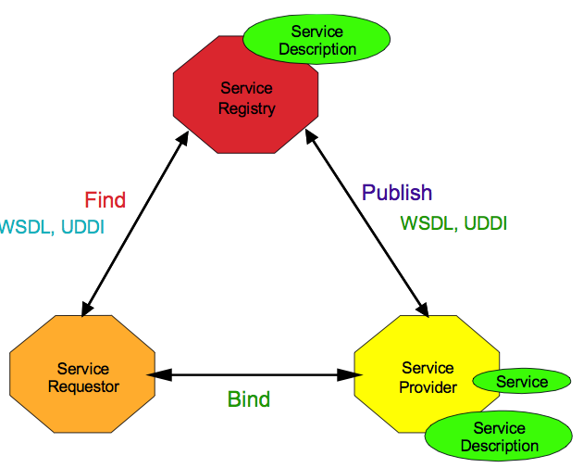
How SOAP, WSDL and UDDI are Related?
SOAP

Slide 7
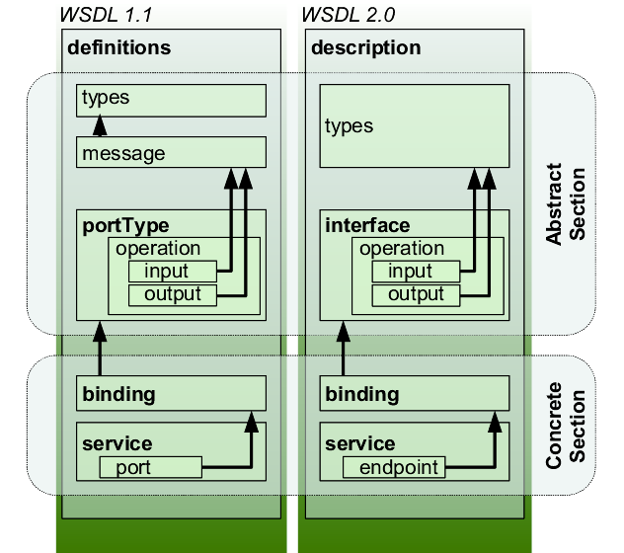
WSDL
types:“a container for data type definitions using some type system (such as XSD)”.
portType/interface: “an abstract set of operations supported by one or more endpoints”.
binding: “a concrete protocol and data format specification for a particular port type”.
port/endpoint: “a single endpoint defined as a combination of a binding and a network address”.

Slide 8
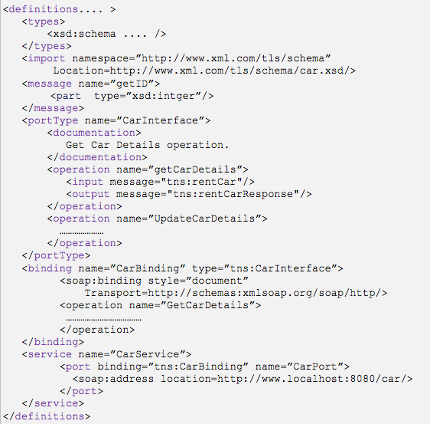


Type
Message
WSDL 1.1 elements
Service
Interface
Definition
PortType
Binding
Service
Service
Implementation
Definition
Port

Slide 9
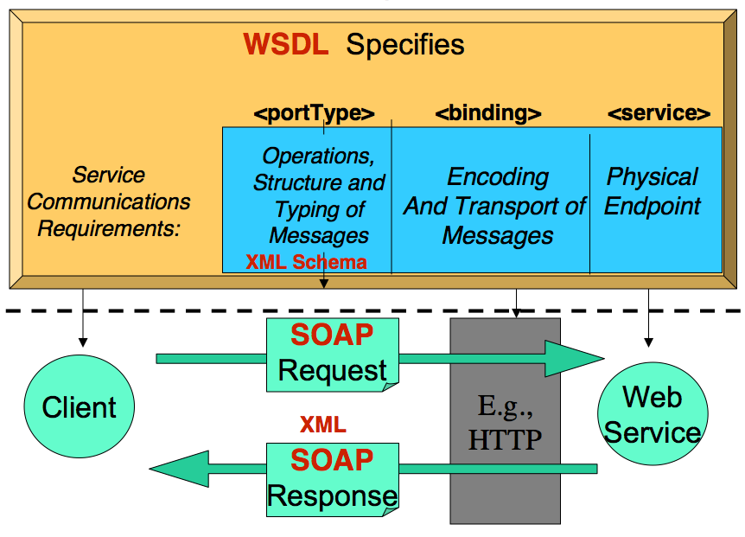
WSDL to SOAP Mapping

Slide 10
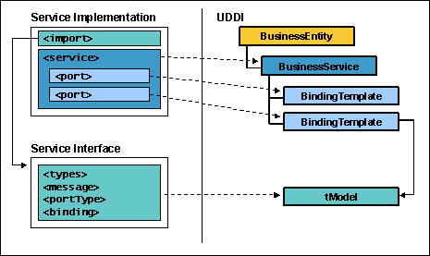
WSDL to UDDI Mapping

Slide 11
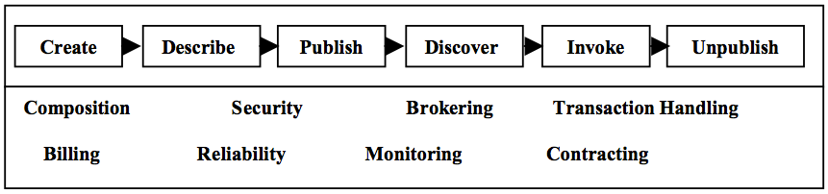
Service Oriented Architecture
Definition:
Service-oriented architecture (SOA) is a software design and software architecture design pattern based on discrete pieces of software providing application functionality as services to other applications.
Characteristics
Interoperable, Loosely Coupled, Reusable, Scalable
Value-Added Layer

Slide 12
Web Service and SOA
EAI
Technology Realization
Messaging
EDI / B2B
Web Site/Portal
Distributed Computing
Policies
Frameworks
Standard Protocols
Practices
Universal Support
Existing Assets
Low Cost
Best Practice Approach
Web Service
SOA

Slide 13
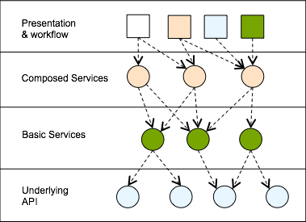
Layers of SOA
Flexible composition.
Reuse.
Functional standardization in lower levels
Customization in higher layers
Separation of concerns.
Policies may vary by layer

Slide 14
Conclusion
Web Service
Available, interoperable, self-contained, modular, distributed, dynamic, of open protocols and standards
Web Service Techniques
SOAP, WSDL, UDDI
Service Oriented Architecture
Greater added value that applications become more flexible
Interoperable, loosely coupled, reusable, scalable

Slide 15
Reference
Wikipedia: http://en.wikipedia.org/wiki/Web_Services_Description_Language
Wikipedia: http://en.wikipedia.org/wiki/SOAP_(protocol)
Wikipedia: http://en.wikipedia.org/wiki/Web_service
Wikipedia: http://en.wikipedia.org/wiki/XML-RPC
Wikipedia: http://en.wikipedia.org/wiki/Service-oriented_architecture
Web Services Conceptual Architecture (WSCA 1.0) May 2001. By Heather Kreger IBM Software Group.
Web Services Technologies : State of the Art. Albreshne, Abdaldhem; Fuhrer, Patrik; Pasquier, Jacques. September 2009.
Web Services Technologies XML and SOAP WSDL and UDDI Version 16, Object Management Group, http://www.omg.org/news/meetings/workshops/MDA-SOA-WS_Manual/00-T1_Newcomer/CH2-WSTechnologies_V16-Standard.pdf
Understanding WSDL in a UDDI registry, http://www.ibm.com/developerworks/library/ws-wsdl/
Service Oriented Architecture: Right on Track, TechNet & MSDN, Microsoft. http://download.microsoft.com/download/e/9/d/e9d163db-5c96-46bc-9263-aac62fc38831/Service%20Oriented%20Architecture.pdf

